Slide 1
MeTube
Database Management Systems (CpSc 4620)
Chris Levesque
Nathan Jones
Z. Schafer LeMieux

Slide 2

Overview
Project Introduction
Getting Started
Process Discussion
Learning Outcomes
Demo
Final Thoughts

Slide 3
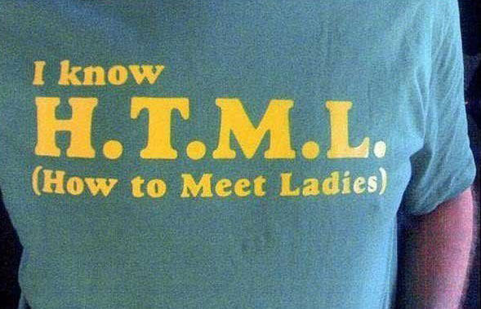




Introduction

Slide 4

Getting Started

Slide 5
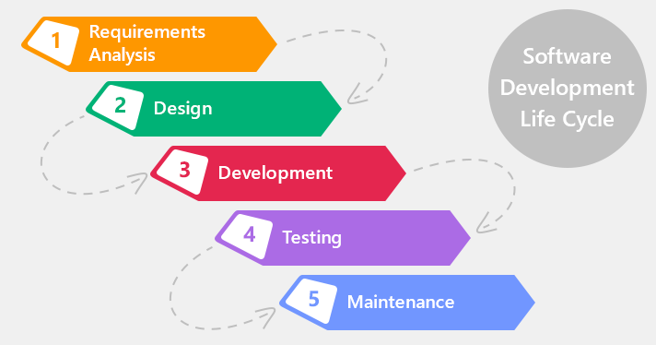
Process

Slide 6
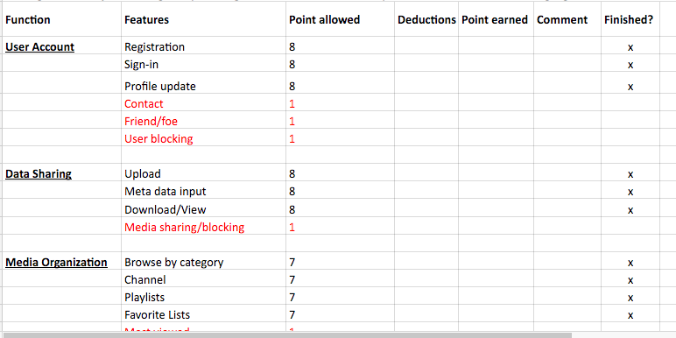
Requirements Analysis

Slide 7
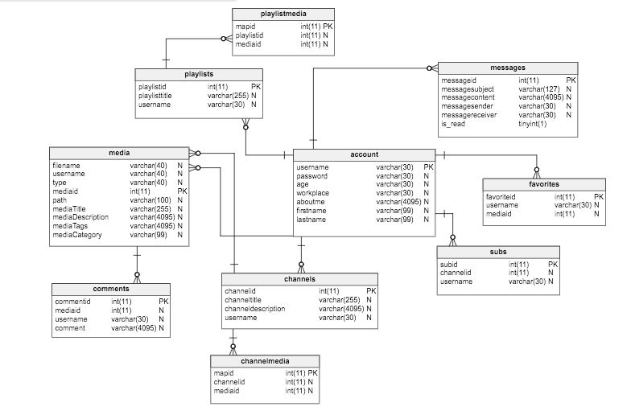
Process - Database Schema - Design

Slide 8
ER Diagram
Design

Slide 9
Development and Testing

Slide 10
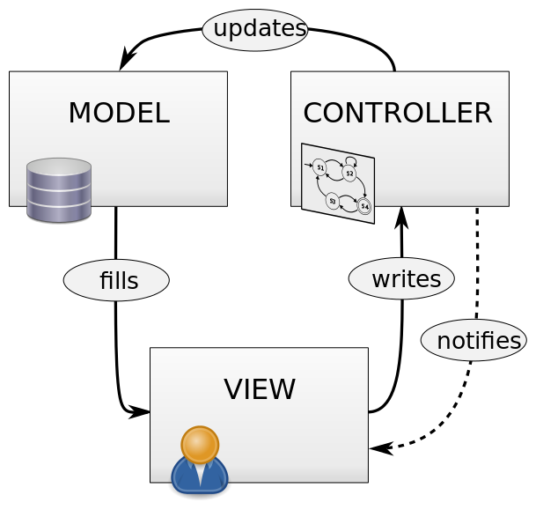
Process - Model View Controller

Slide 11
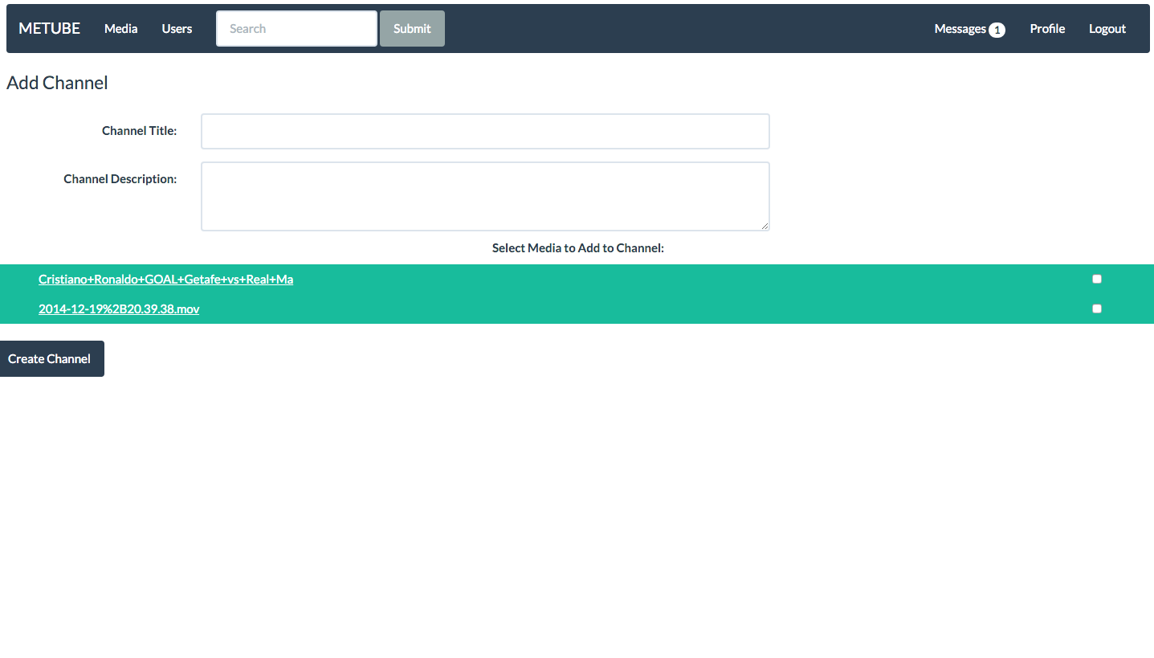
View
add_channel.php sends an HTML form to add_channel_process.php
HTML, CSS, PHP

Slide 12
User Input (View) to Controller
add_channel.php →
media_upload.php →
favorites.php →
add_media_to_channel.php →
profile_update.php →
add_channel_process.php
media_upload_process.php
favorites_process.php
add_media_to_channel_process.php
profile_update _process.php

Slide 13
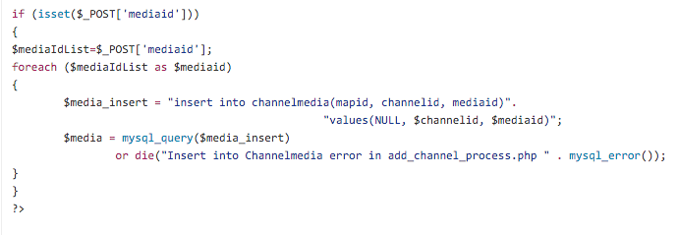
Controller
add_channel_process.php sends a MySQL query to the database
PHP, MySQL Queries

Slide 14
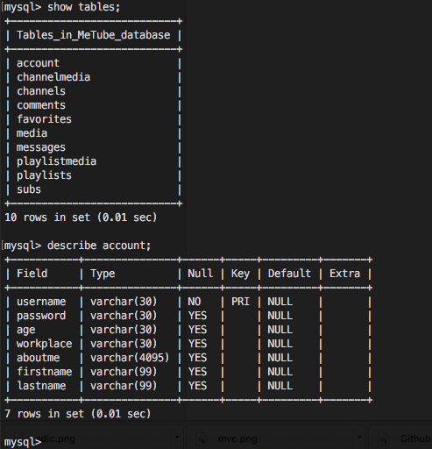
Model
MySQL Database

Slide 15
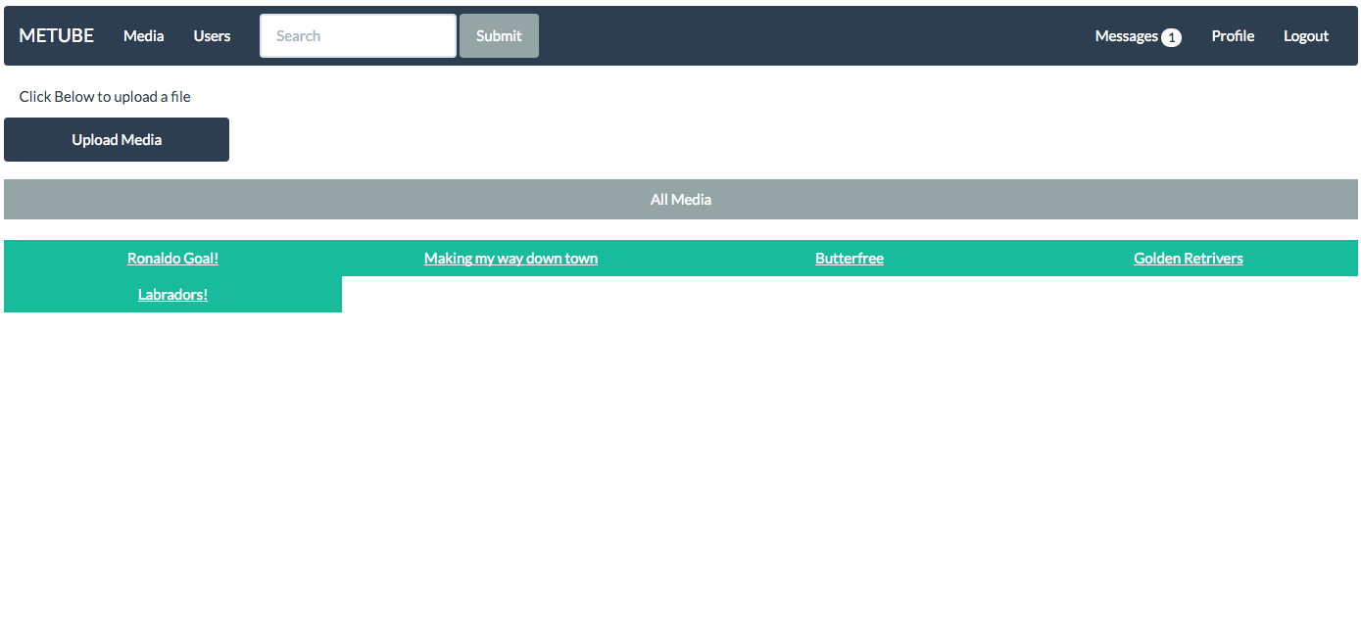
View All Media

Slide 16
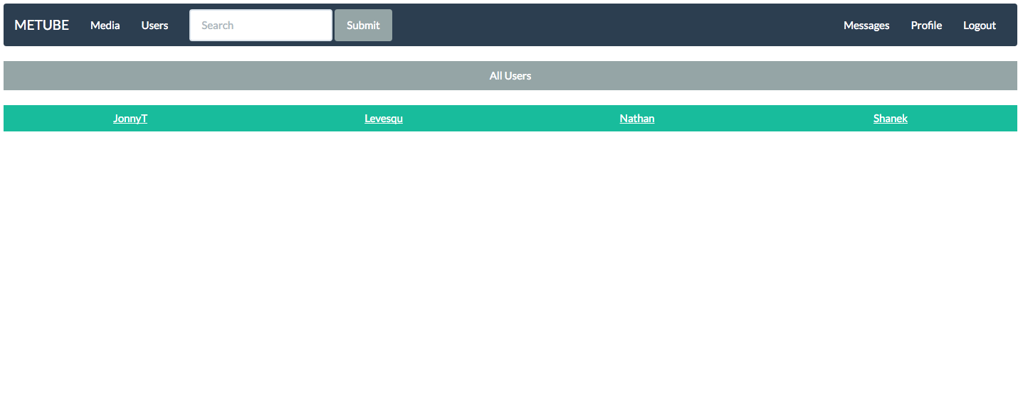
See All Users

Slide 17
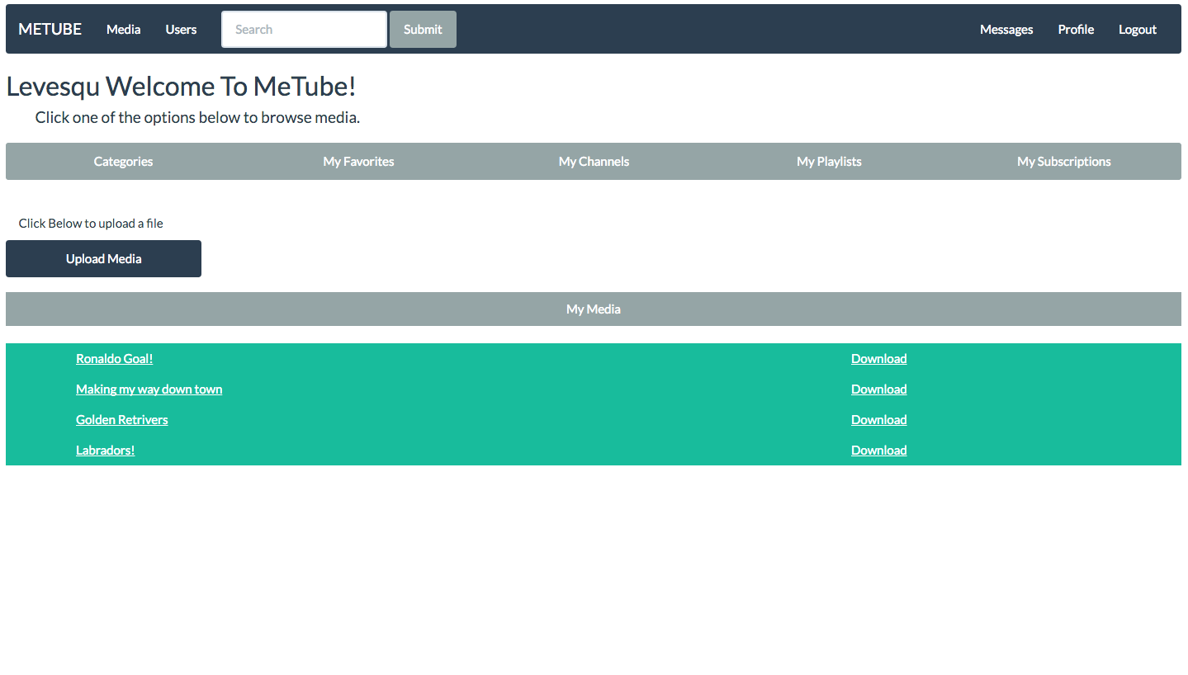
View Your Media

Slide 18
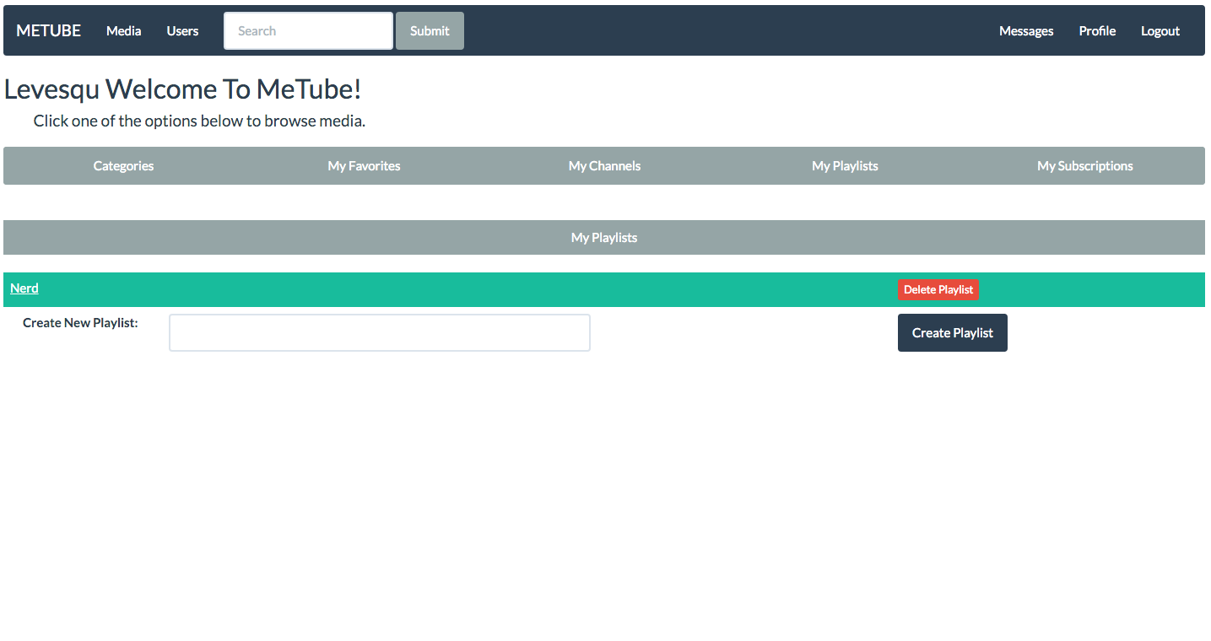
Make Playlists

Slide 19
Create Channels

Slide 20
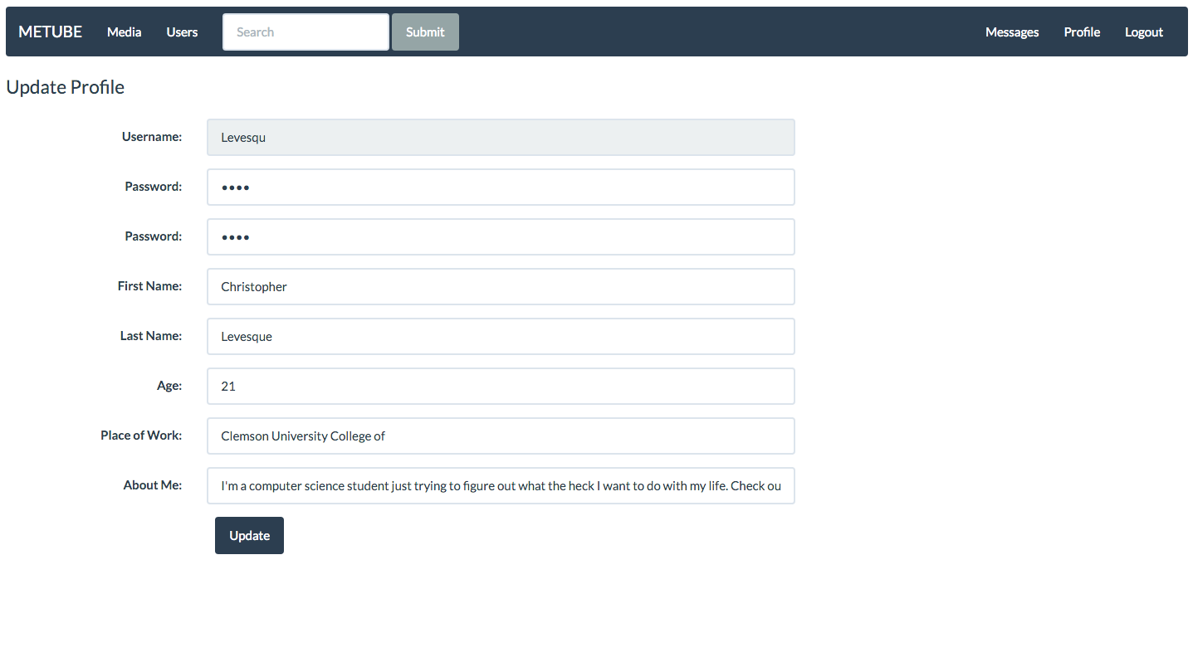
Update Your Profile

Slide 21
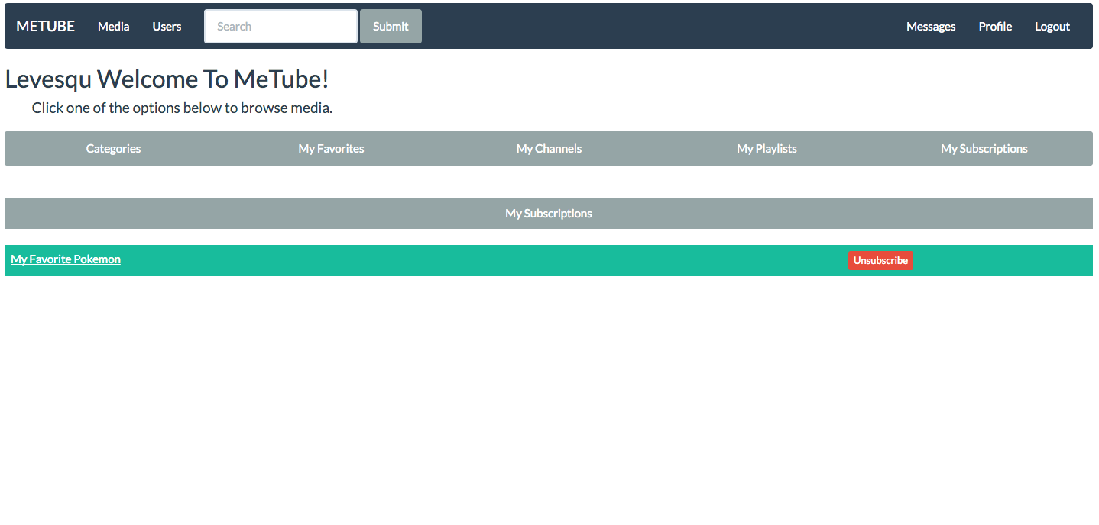
Subscribe

Slide 22
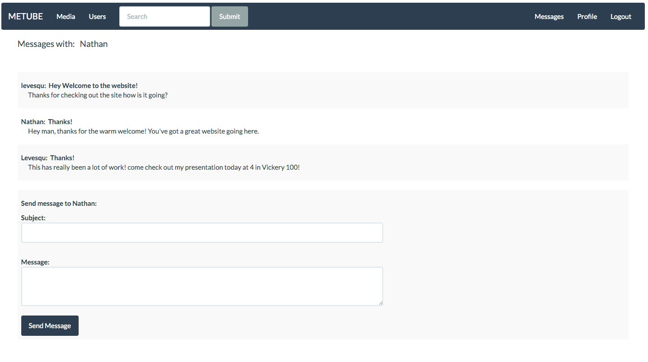
Messages

Slide 23


Slide 24
Life after MeTube..

Slide 25
UsTube

